Slide 1
W4153 – Cloud Computing Lecture 11: FaaS, EDA, GW, GraphQL, Kubernetes
© Donald F. Ferguson, 2024

Slide 2

Contents
2 | W4153-F24-11-FaaS-EDA-GW-GraphQL-Kubernetes © Donald F. Ferguson, 2024

Slide 3
Contents
Interesting Ed question
Implementing and deploying application logic and microservices — overview, reminder, options.
Function-as-a-Service
More advanced composition
Event driven architecture
Message driven architecture
API Gateway
GraphQL

Slide 4
Interesting Ed Question
4 | W4153-F24-11-FaaS-EDA-GW-GraphQL-Kubernetes © Donald F. Ferguson, 2024

Slide 5
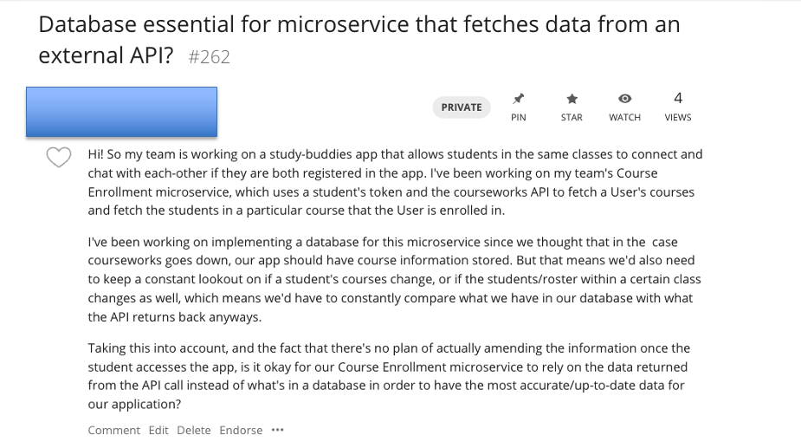
Interesting Ed Question

Slide 6
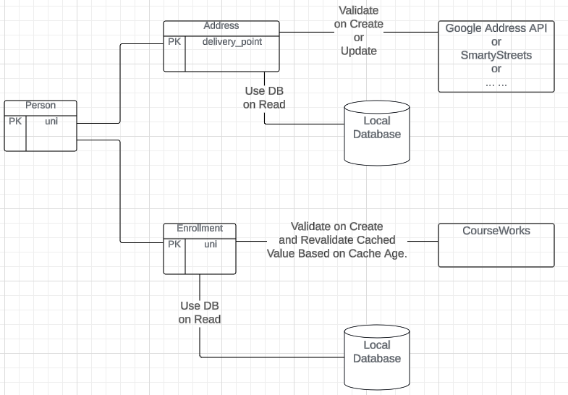
My Examples
My example application uses:
CourseWorks
An address verification API
SmartyStreets
Google
In general, “always” access the API is not the best practice:
Performance, reliability, … …
API usage costs
I typically implement some form of caching and verification based on knowledge of the domain.
Validate on an update
Refresh of read when cache entry is older then … …
Some application support subscribing to change notification events.

Slide 7
Implementing and Deploying Microservices
7 | W4153-F24-11-FaaS-EDA-GW-GraphQL-Kubernetes © Donald F. Ferguson, 2024

Slide 8
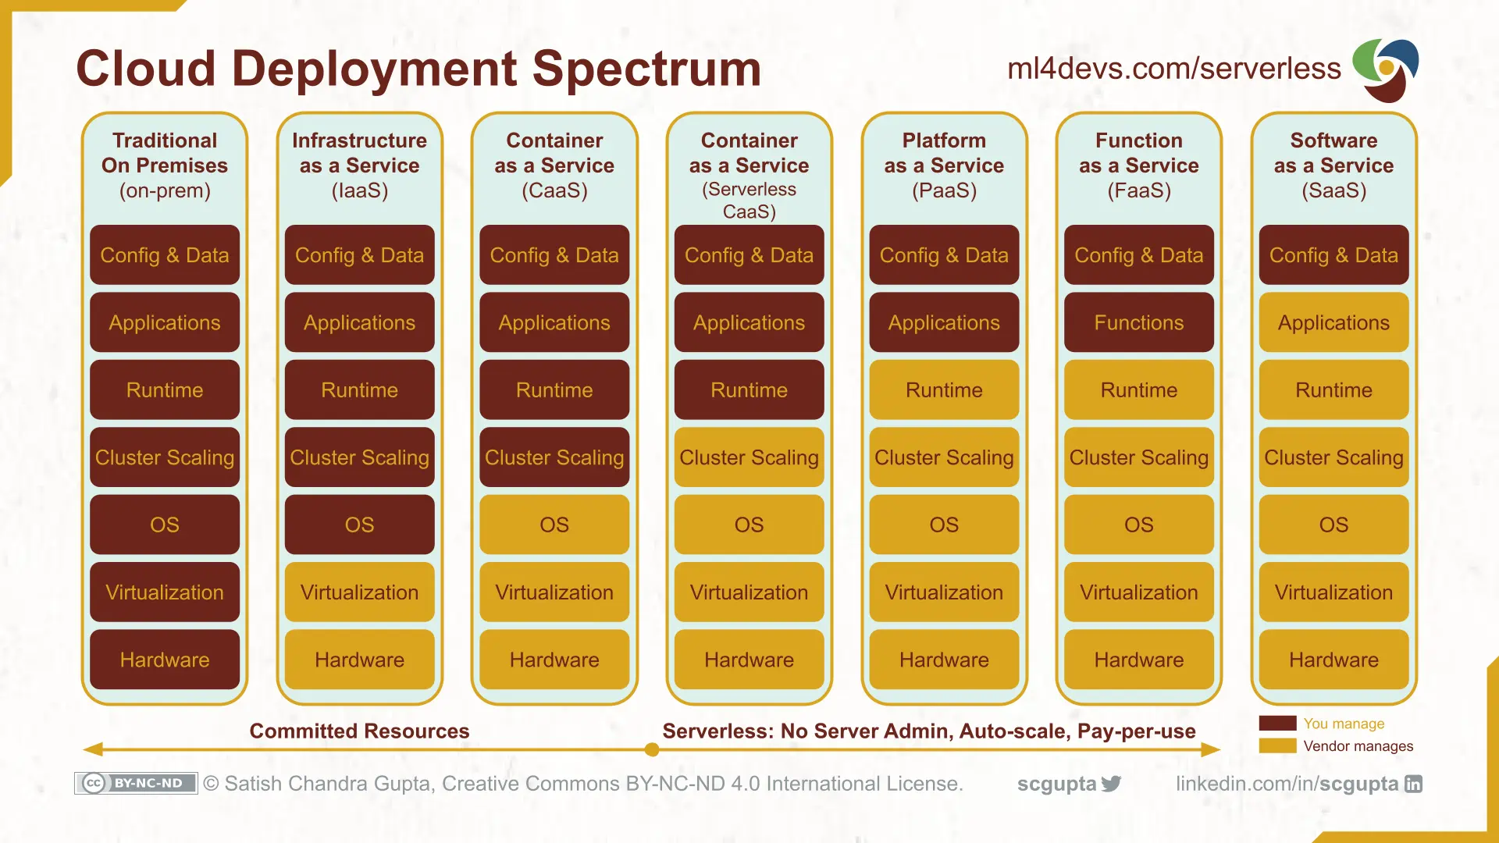
Cloud Layers

Slide 9
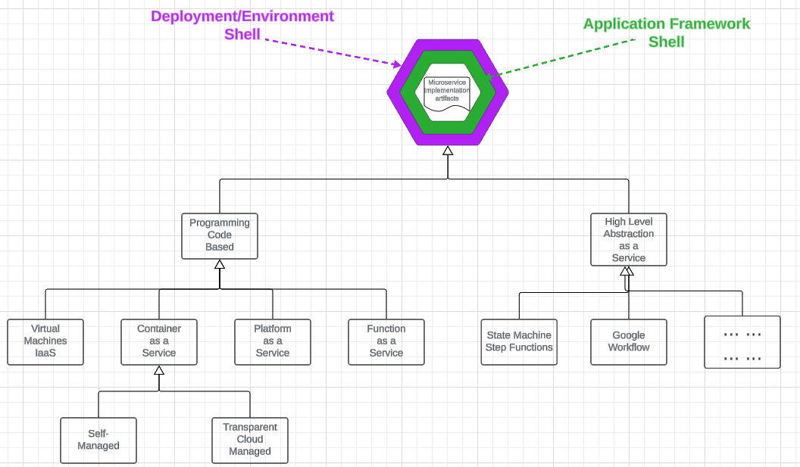
Implementing and Deploying Microservices
There are several approaches or models for implementing microservice “application” logic.
“Code” in a language like Go, Python, … is the most common.
There are other, specialized, more abstract domain specific languages, e.g.
Step Functions/State Machines
Workflows
Data flows
… …
A deployed microservice has three logical layers of functions:
Deployment shell functions.
Application framework functions
Application logic
Cloud Provider Managed based on policies and parameters.
For example, Elastic Kubernetes Service

Slide 10
Implementing and Deploying Microservices
“Code” is by far the most common.
Domain Specific Languages and their runtime environments:
Have a learning curve and seem complex.
Are extremely useful for certain complex scenarios.
We have focused on ”code” and will continue to do so.
We have seen a few deployment options: IaaS, Self-Managed CaaS, PaaS, …
We will look at more complex self-managed CaaS and understand, e.g. Kubernetes, but not use.
Today we will examine Function-as-a-Service.
We will get some simple experience with a higher layer, DSL approach.

Slide 11
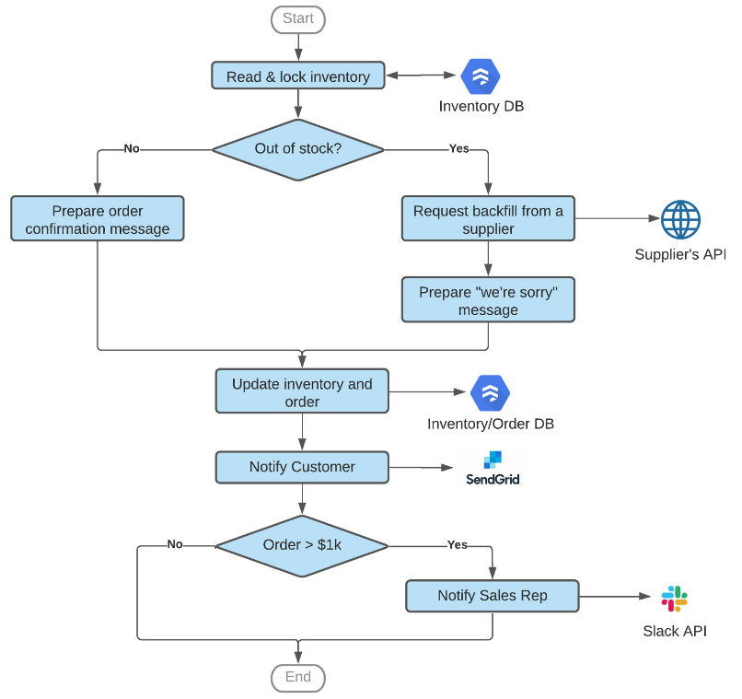
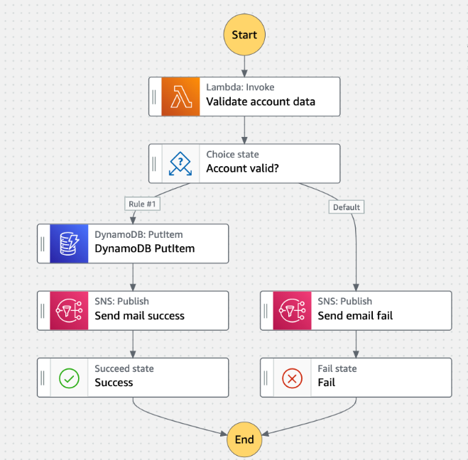
Higher Layer Languages
Google Workflows
AWS Step Functions
https://cloud.google.com/blog/products/application-development/get-to-know-google-cloud-workflows

Slide 12
Function-as-a-Service
12 | W4153-F24-11-FaaS-EDA-GW-GraphQL-Kubernetes © Donald F. Ferguson, 2024

Slide 13

Computer Models
Hardware
At the very core, you write a function or method.
A set of functions or methods become a resource.
A resource runs in a web application and uses required software, e. g. packages, libraries.
A web application run in some kind of container, which provides isolation, ensures pre-reqs, etc.
Containers run in an operating system.
An operating systems runs on HW, which may be a virtual machine and virtual resources.
Virtual resources run on hypervisors, which
Run on hardware.
This is like a matryoshka doll. Ultimately, I decide:
Which level of nesting is the package I am willing to/want to produce and deploy.
I provide that as a package/bundle and provide a declaration/manifest of what I want created and managed automatically for me.
This is over simplified and the boundaries blur.
Hypervisor
Virtual Machine
Operating System
Container
Web Application
Resource
Function/Method

Slide 14
Serverless and Function-as-a-Service
Serverless computing is a cloud computing execution model in which the cloud provider runs the server, and dynamically manages the allocation of machine resources. Pricing is based on the actual amount of resources consumed by an application, rather than on pre-purchased units of capacity.^{[1]} It can be a form of utility computing. Serverless computing can simplify the process of deploying code into production. Scaling, capacity planning and maintenance operations may be hidden from the developer or operator. Serverless code can be used in conjunction with code deployed in traditional styles, such as microservices. Alternatively, applications can be written to be purely serverless and use no provisioned servers at all.^{[2]} This should not be confused with computing or networking models that do not require an actual server to function, such as peer-to-peer (P2P).”
Function as a service (FaaS) is a category of cloud computing services that provides a platform allowing customers to develop, run, and manage application functionalities without the complexity of building and maintaining the infrastructure typically associated with developing and launching an app.^{[1]} Building an application following this model is one way of achieving a "serverless" architecture, and is typically used when building microservices applications.”
That was baffling:
IaaS, CaaS – You control the SW stack and the cloud provides (virtual) HW.
PaaS – The cloud hides the lower layer SW and provides an application container (e.g. Flask) with “Your code goes here.” You are aware of container.
FaaS – The cloud provides the container, and you implement functions (corresponding to routes in REST).

Slide 15
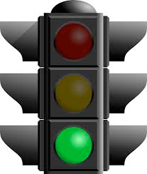
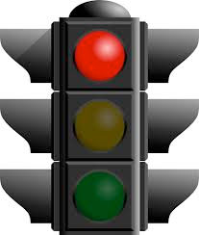







What is Serverless Good/Not Good For ... ...
Serverless is good for
short-running
stateless
event-driven
Serverless is not good for
long-running
stateful
number crunching
Microservices
Databases
Mobile Backends
Deep Learning Training
Bots, ML Inferencing
Heavy-Duty Stream Analytics
IoT
f(x)
Numerical Simulation
Modest Stream Processing
Video Streaming
Service integration

Slide 16
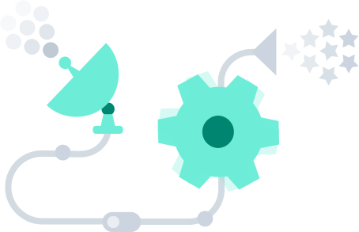
What triggers code execution?
Runs code in response to events
Event-programming model
Notes:
What is Serverless

Slide 17


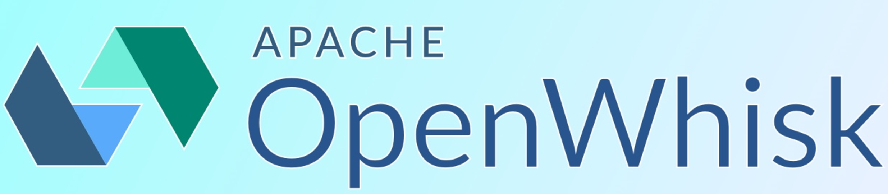
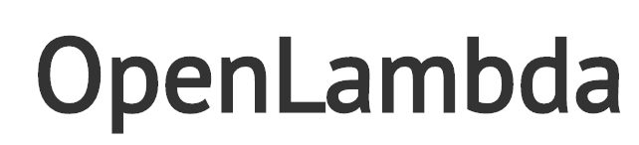


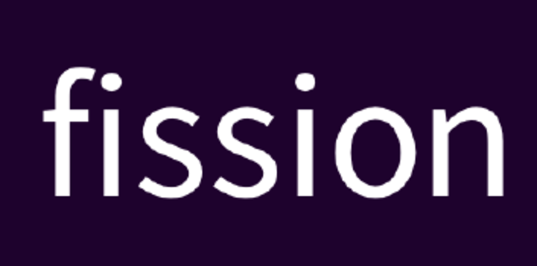
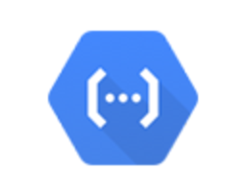

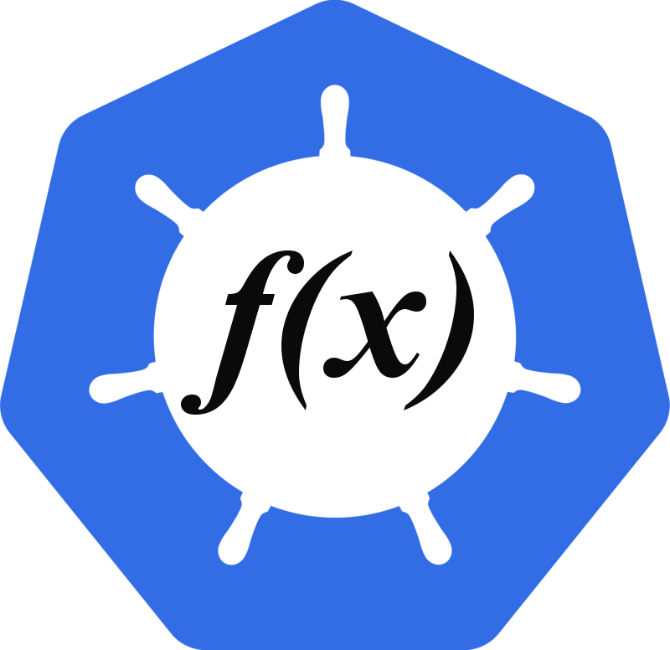

(Some) Current Platforms for Serverless
AWS Lambda
Azure Functions
Kubernetes
IBM Cloud Functions
Red-Hat
Google Functions
Notes:
Auth0, Twitter, ..
And many more upcoming / open source

Slide 18
Google Cloud Function Example
Pub_Sub_New: /Users/donald.ferguson/Dropbox/000/00-Current-Repos/Pub_Sub_New
Explain concepts
Discord
Google Cloud Function
Google Pub Sub
Run demos

Slide 19
Composition
19 | W4153-F24-6-REST(4)-OAuth2-Middleware-Composition © Donald F. Ferguson, 2024

Slide 20
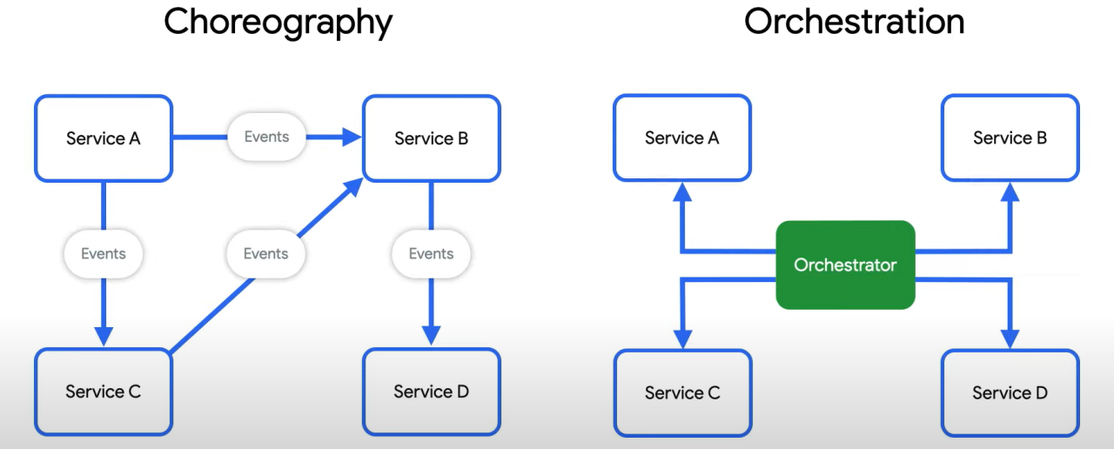
Behavioral Composition
There are two base patterns: choreography and orchestration.
There also several different implementation technologies and choices.
And many related concepts, e.g. Sagas, Event Driven Architectures, Pub/Sub, … …
We will cover and explore incrementally, but for now we will keep it simple and do traditional “if … then …” code.

Slide 21
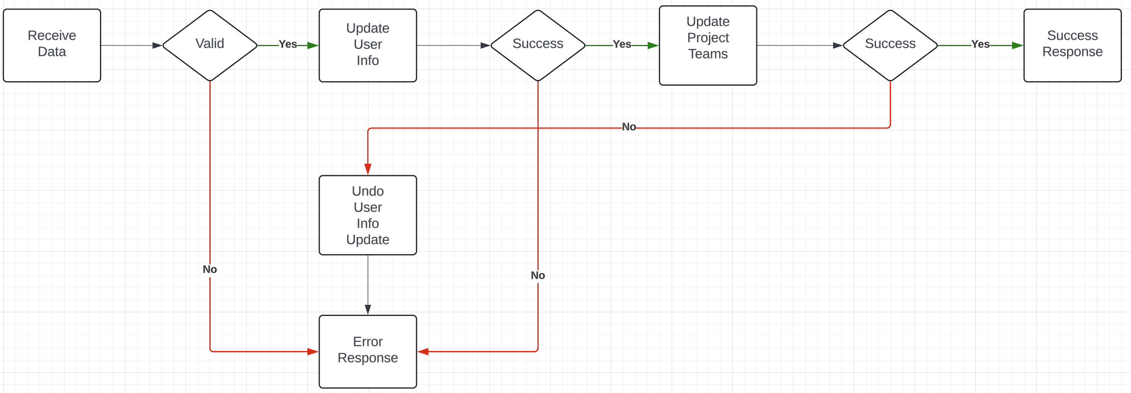
Composite Microservice Logic
The GET on the composite invokes GET on several atomic services. This can occur synchronously or asynchronously in parallel.
PUT, POST and DELETE are more complex. Your logic may have to undo some delegated updates that occur if others fail.
To get started, we will just use simple logic but explore more complex approaches.

Slide 22
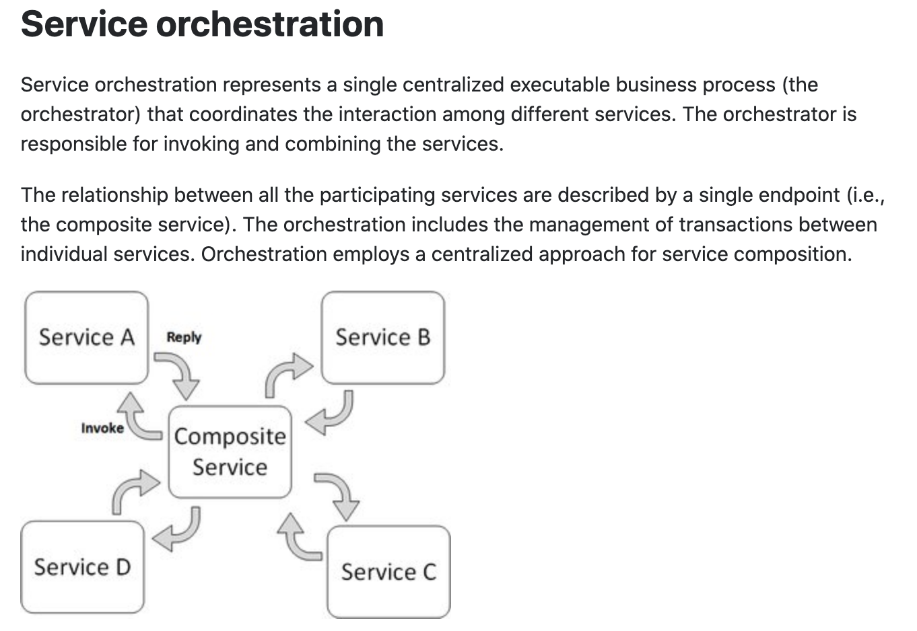
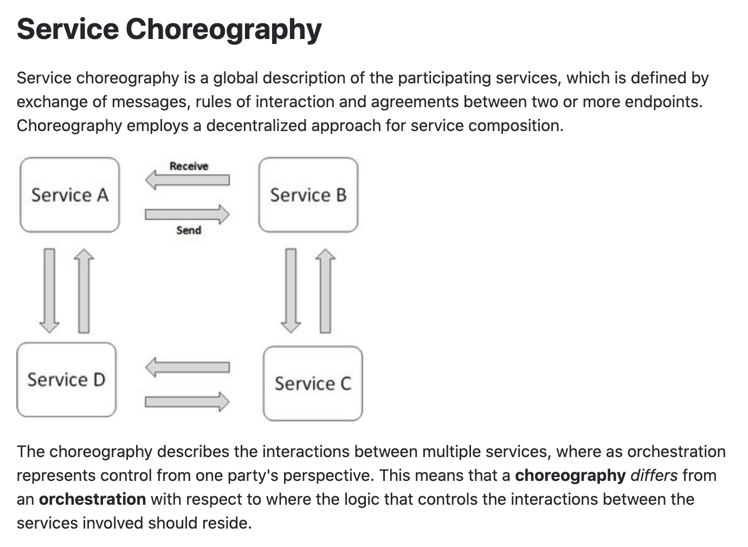
Concepts
These are not formally, rigorously defined terms.

Slide 23
In Code: Composition and Asynchronous Method Invocation
Composite operations can “take a while.”
“Holding open connections and waiting can be bad.”
Consumes resources.
Connections can break.
... ...
There are two options:
Polling
Callbacks
Our next pattern is composition and “polling.” Create a new user requires:
Updating the user database.
Verifying a submitted address.
Creating an account in the catalog service.
Request
202 ACCEPTED Location
GET (Poll)
200

Slide 24
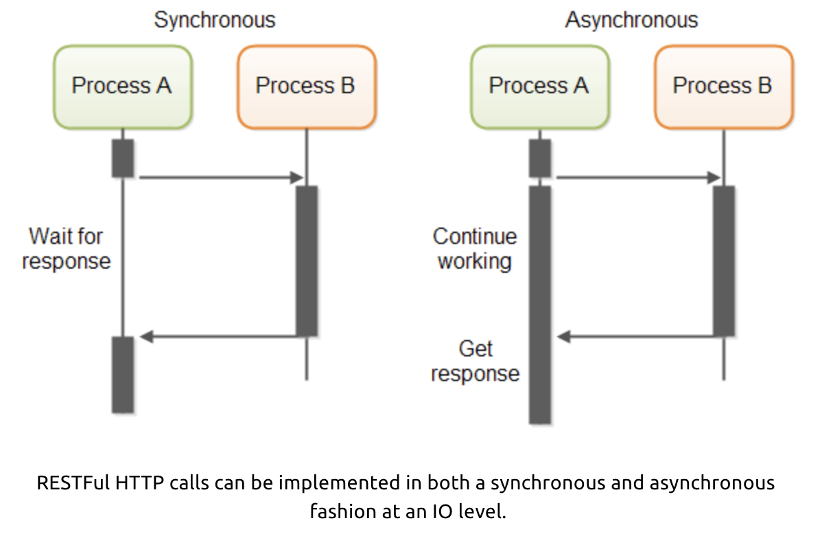
In Code: Service Orchestration/Composition
One call to a composite service
May drive calls to multiple other services.
Which in turn, may drive multiple calls to other services.
Synchronous (Wait) and calling one at a time, in order is
Inefficient
Fragile
... ...
Asynchronous has benefits but can result in complex code.

Slide 25
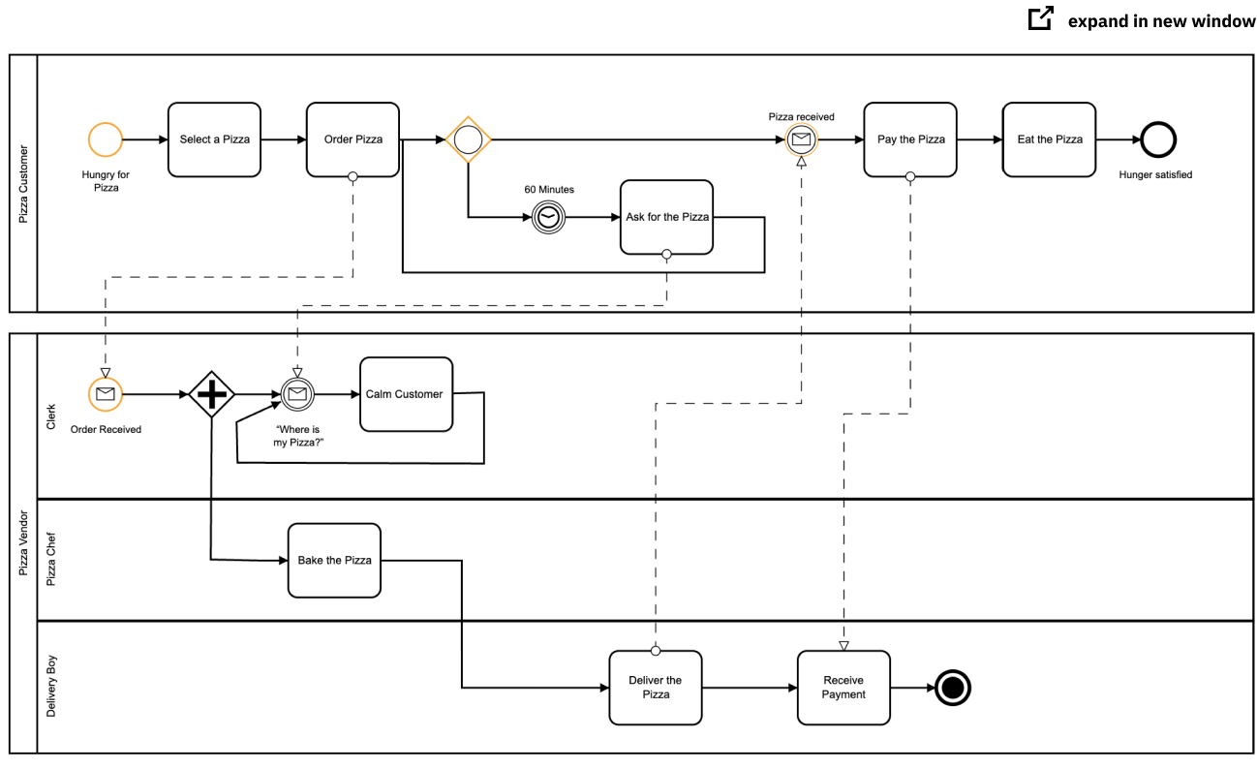
Service Orchestration
Implementing a complex orchestration in code can become complex.
High layer abstractions and tools have emerged, e.g. BPMN.
“Business Process Model and Notation (BPMN) is a graphical representation for specifying business processes in a business process model.”
There are products for defining BPMN processes, generating code, executing, … …, e.g. Camunda: https://camunda.com/bpmn/
There are other languages, tools, execution engines, … …

Slide 26
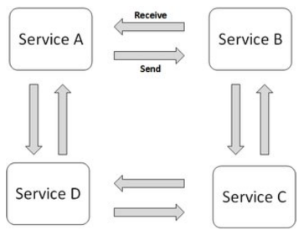
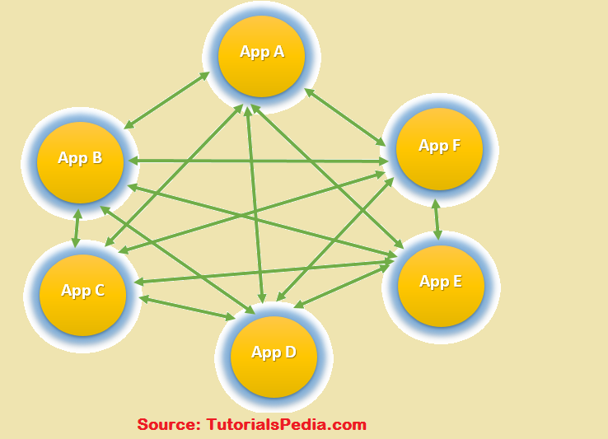
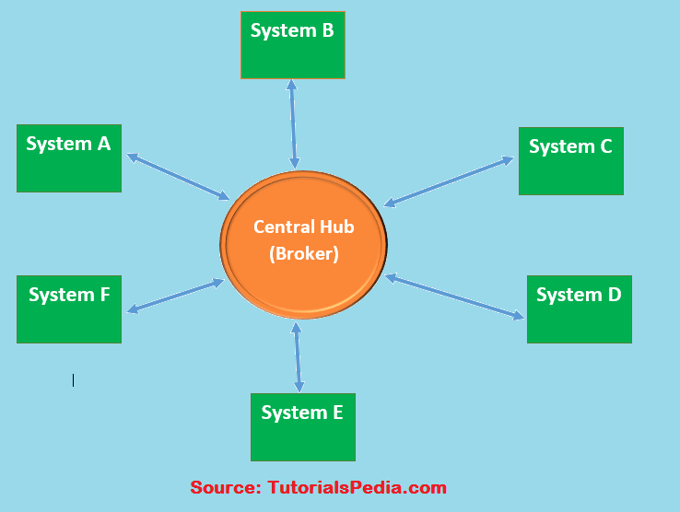
Choreography
We saw the basic diagram, but … this is an anti-pattern and does not scale.
But, how do you write the event driven microservices?
Well, you can just write code … …
Or use a state machines abstraction.
… …

Slide 27
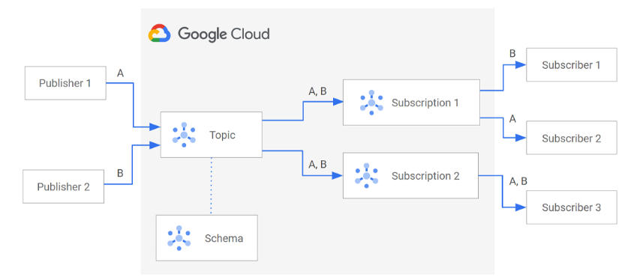
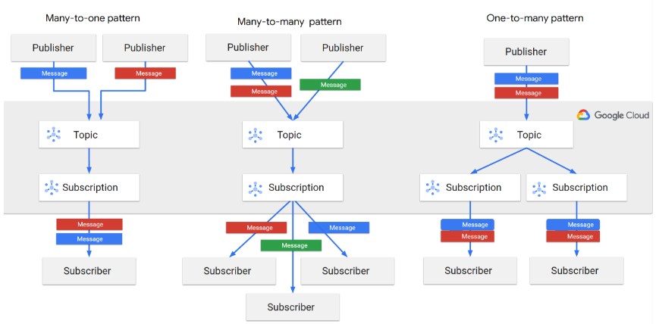
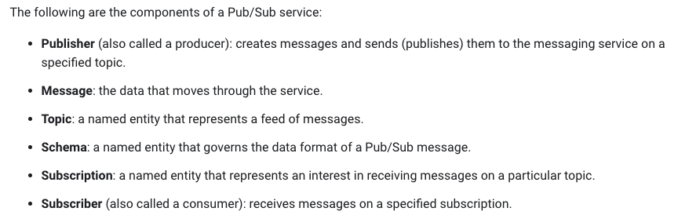
Google Pub Sub

Slide 28
Show Examples

Slide 29
API Gateway
29 | W4153-F24-11-FaaS-EDA-GW-GraphQL-Kubernetes © Donald F. Ferguson, 2024

Slide 30
Terms
From Wikipedia
“API management is the process of creating and publishing web application programming interfaces (APIs), enforcing their usage policies, controlling access, nurturing the subscriber community, collecting and analyzing usage statistics, and reporting on performance. API Management components provide mechanisms and tools to support developer and subscriber communities.”
Gateway: A server that acts as an API front-end, receives API requests, enforces throttling and security policies, passes requests to the back-end service and then passes the response back to the requester. A gateway often includes a transformation engine to orchestrate and modify the requests and responses on the fly. A gateway can also provide functions such as collecting analytics data and providing caching. The gateway can provide the functionality to support authentication, authorization, security, audit and regulatory compliance. Gateways can be implemented using technologies like Nginx or HAProxy.

Slide 31
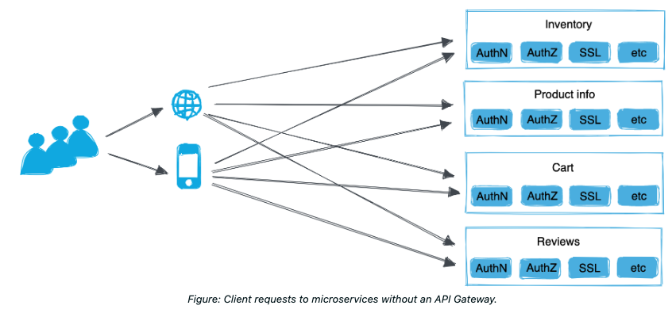
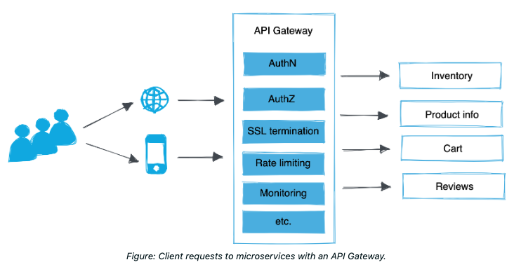
https://docs.solo.io/gloo-mesh-gateway/main/concepts/about/api-gateway/
Solo.io is an example (this is not a recommendation): https://docs.solo.io/gloo-mesh-gateway/main/concepts/about/api-gateway/
There are many, many API GWs
All major cloud service providers have one or more API gateways.
There are several open-source API GWs.
There are several commercial products.

Slide 32
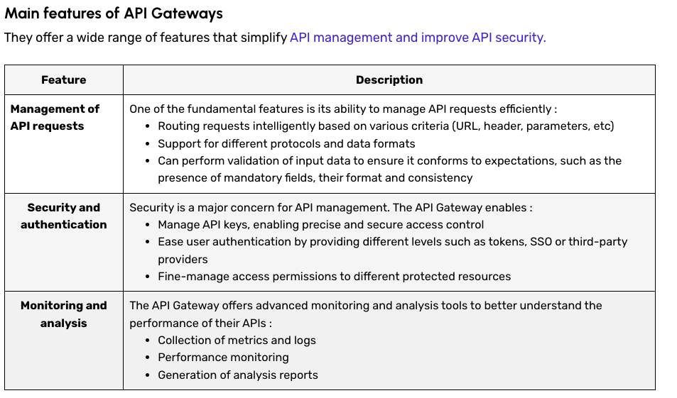
API Gateway
https://datascientest.com/en/api-gateway-how-it-works-and-its-advantages

Slide 33
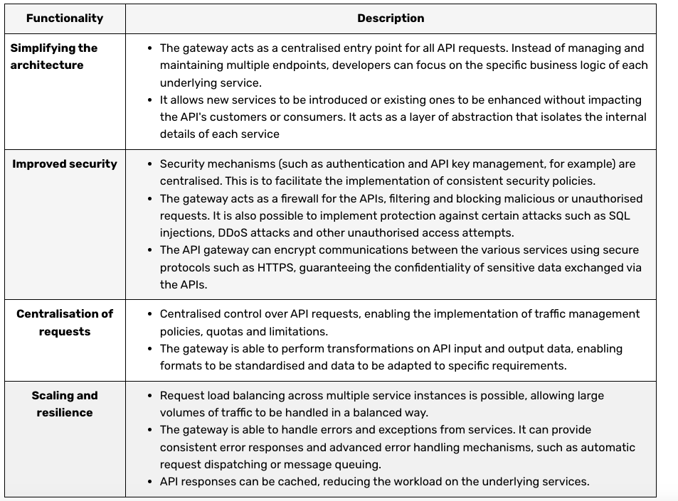
API Gateway Benefits

Slide 34
Overall Architecture
34 | W4153-F24-11-FaaS-EDA-GW-GraphQL-Kubernetes © Donald F. Ferguson, 2024

Slide 35
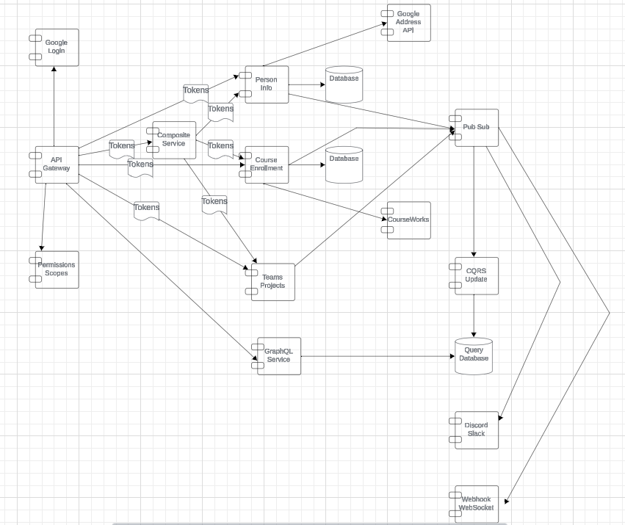
Overall Architecture
API Gateway
Enforces login
Generates observability scope
Updates tokens returned to client
Authorization:
Permissions and scopes generates a signed JWT token with claims.
Each microservice authorizes request based on JWT, URL, … …
All microservices:
Check authorization in middleware
Log before/after in middleware
Generate “update event” on PUT/POST/DELETE
Pub/Sub for: CQRS, Discord/Slack, Webhook/Slack
GraphQL

